Slide 1








Movie Recommender System
Team ID - CU_CP_Team_8767
Nishant Verma
Dhruvi Rajput
Tamanna Singh
Tejas Solanki

Slide 2

Project Objectives
Problem Statement
Project Overview – Introduction
Filtering Method
End Users
Wow Factor in Project
Modelling/Block Diagram/Flow of Project
Result/outcomes
Conclusion
Future Perspective

Slide 3
Problem Statement
With the vast and ever-growing number of movies and TV shows available across various platforms, users often face difficulty in choosing what to watch.
This content overload leads to decision fatigue and wasted time scrolling through recommendations that don’t align with user preferences. Additionally, most streaming platforms provide generic suggestions based on popularity rather than personalized taste, missing the opportunity to enhance user engagement through intelligent recommendations.
There's a need for a smarter system that provides relevant, insightful, and user-centric movie suggestions.
Users are overwhelmed by the vast number of movies and TV shows available.
Current recommendation systems often lack personalization and rely on popularity rather than user taste. This causes decision fatigue and unsatisfying content choices.

Slide 4
Project overview - Introduction
The Movie Recommendation System is a web-based application designed to enhance user experience in discovering new movies tailored to individual preferences.
Developed using Streamlit, a powerful and lightweight web application framework in Python, the system offers a seamless and interactive interface.
It integrates the TMDb (The Movie Database) API, that provides programmatic access to a comprehensive database of movies, TV shows, actors, and related information.
It allows developers to fetch data, images, and other resources through structured HTTP requests and responses.
The core functionality revolves around recommending movies similar to a user's selected title using content-based filtering techniques.
These recommendations are generated based on key attributes such as genre, cast, director, and user ratings

Slide 5
Filtering Method (Content-Based Filtering)
This approach recommends items based on their features, like genres for movies or ingredients for recipes.
It analyzes the user's preferences by looking at their past interactions and explicit feedback, such as ratings or likes.
If a user likes a specific movie, the system will suggest other movies with similar genres or actors.
Content-based filtering doesn't rely on other users' data, making it good for new users or items with little user interaction data.

Slide 6
End Users
Movie enthusiasts:
Individuals who are passionate about films and actively seek out new, engaging content to watch. They benefit from curated recommendations tailored to their viewing history or genre preferences. The system helps them discover hidden gems and stay updated with the latest releases.
Streaming platform users:
Users who regularly consume content on platforms like Netflix, Amazon Prime, or Disney+. These users often face choice overload due to the abundance of content available.
Developers studying recommendation systems:
Aspiring data scientists and developers interested in machine learning and recommendation engine technologies can use this project as a reference or learning tool.
Content aggregators:
Businesses and services that collect, organize, and present entertainment content (such as movie blogs, review platforms, or OTT dashboards) can integrate or build upon this system to enhance user engagement.

Slide 7
Wow Factor in Solution
Real-time movie data via TMDb API:
The application fetches up-to-the-minute movie information using the TMDb (The Movie Database) API.
Real-time access ensures users receive the latest and most accurate movie information without any manual updates.
Interactive UI with cast bios, reviews, similar movies:
Built using Streamlit, the UI offers an engaging and responsive experience.
Users can explore detailed cast biographies with profile pictures, read user-generated reviews, and view high-quality visuals including movie posters and backdrops.
This makes browsing both informative and visually appealing.
Continuous content discovery flow:
After selecting a movie, users receive not just information about it, but also a list of similar movies intelligently recommended based on content features.

Slide 8
Modelling
The Flow Chart can be divided into five stages:
GUI
{Streamlit}
API Fetch
(TMDb)
User Input
Process Data
{Python}
Display

Slide 9
Result / Outcomes
Functional web app prototype:
The prototype is a fully functional web application that demonstrates all core features of the recommendation system.
The application is modularly built, allowing each component (e.g., API fetch, data processing, UI rendering) to be developed, tested, and maintained independently.
Displays movies, reviews, recommendations dynamically:
The system retrieves and displays movie information in real time.
Each recommendation includes clickable elements that allow users to explore further details, reviews, and additional similar movies, creating a continuous discovery experience.
Smooth user experience:
The application is fully responsive, adapting to various device screens—whether on desktop, tablet, or mobile—making it accessible and functional for a broad audience.
Beyond just presenting static data, the UI is designed to anticipate user needs by highlighting important information.

Slide 10
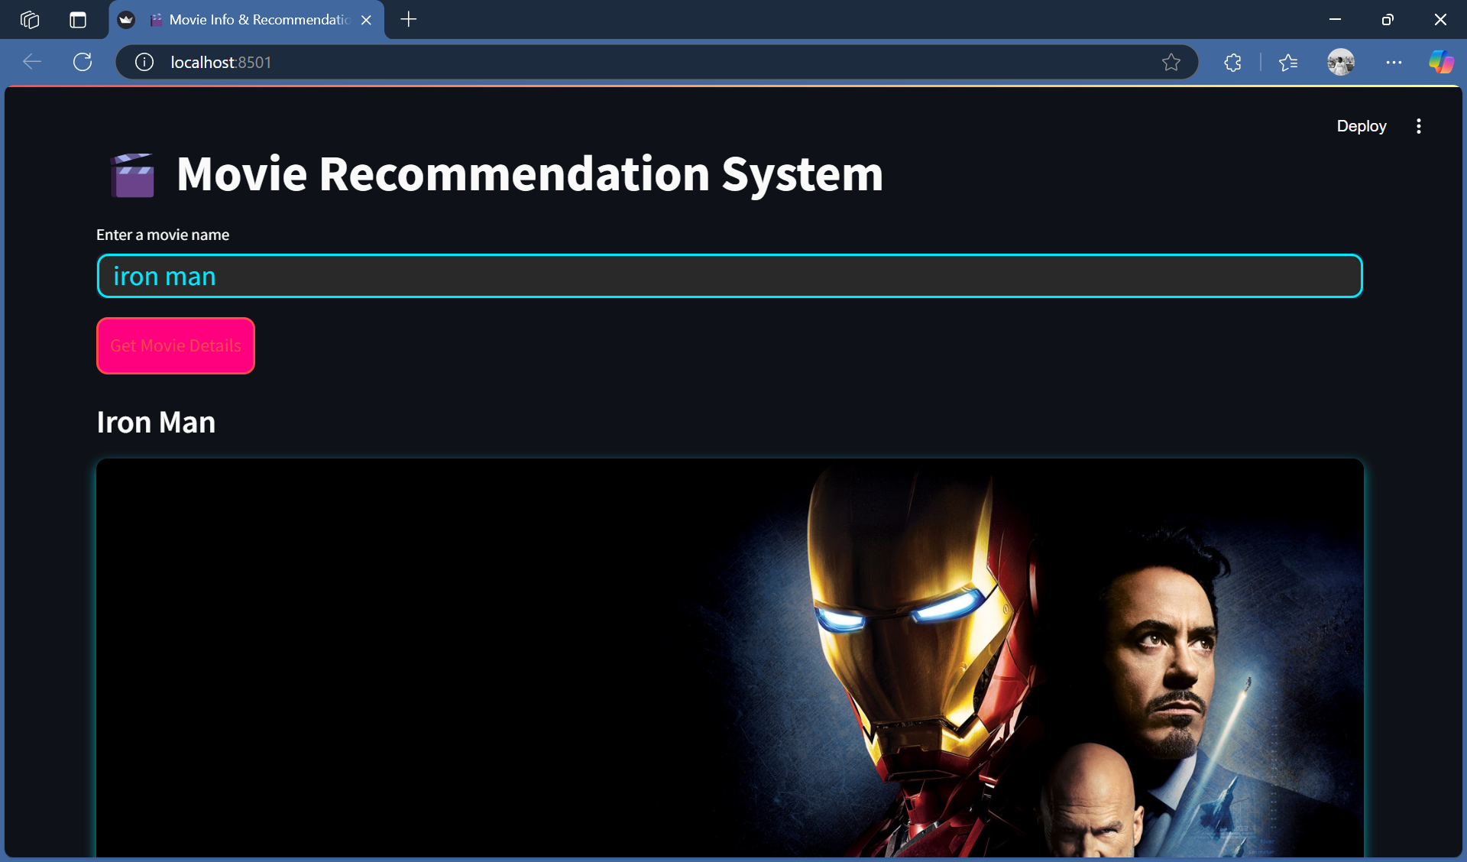
Outcomes of project:

Slide 11
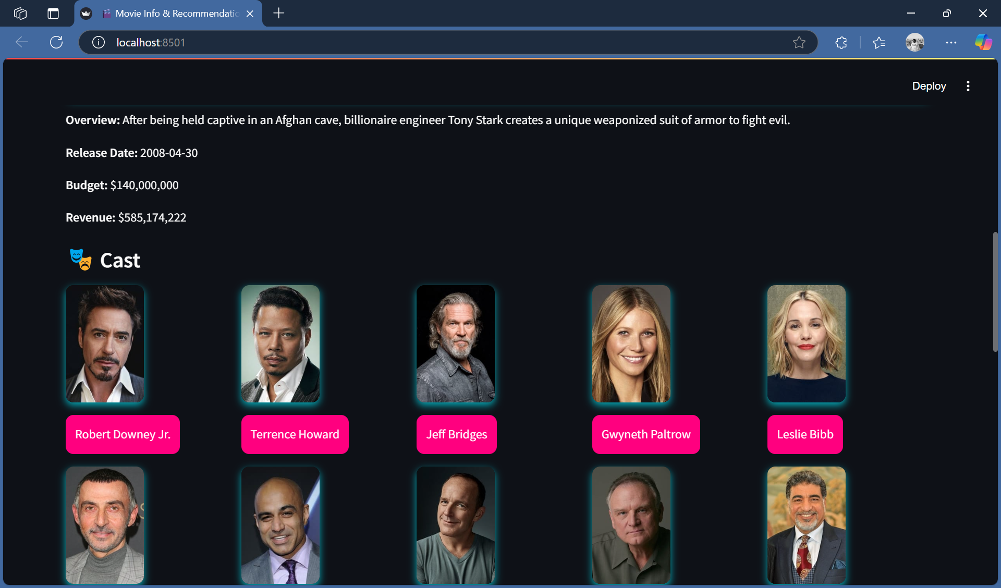
Outcomes of project:

Slide 12
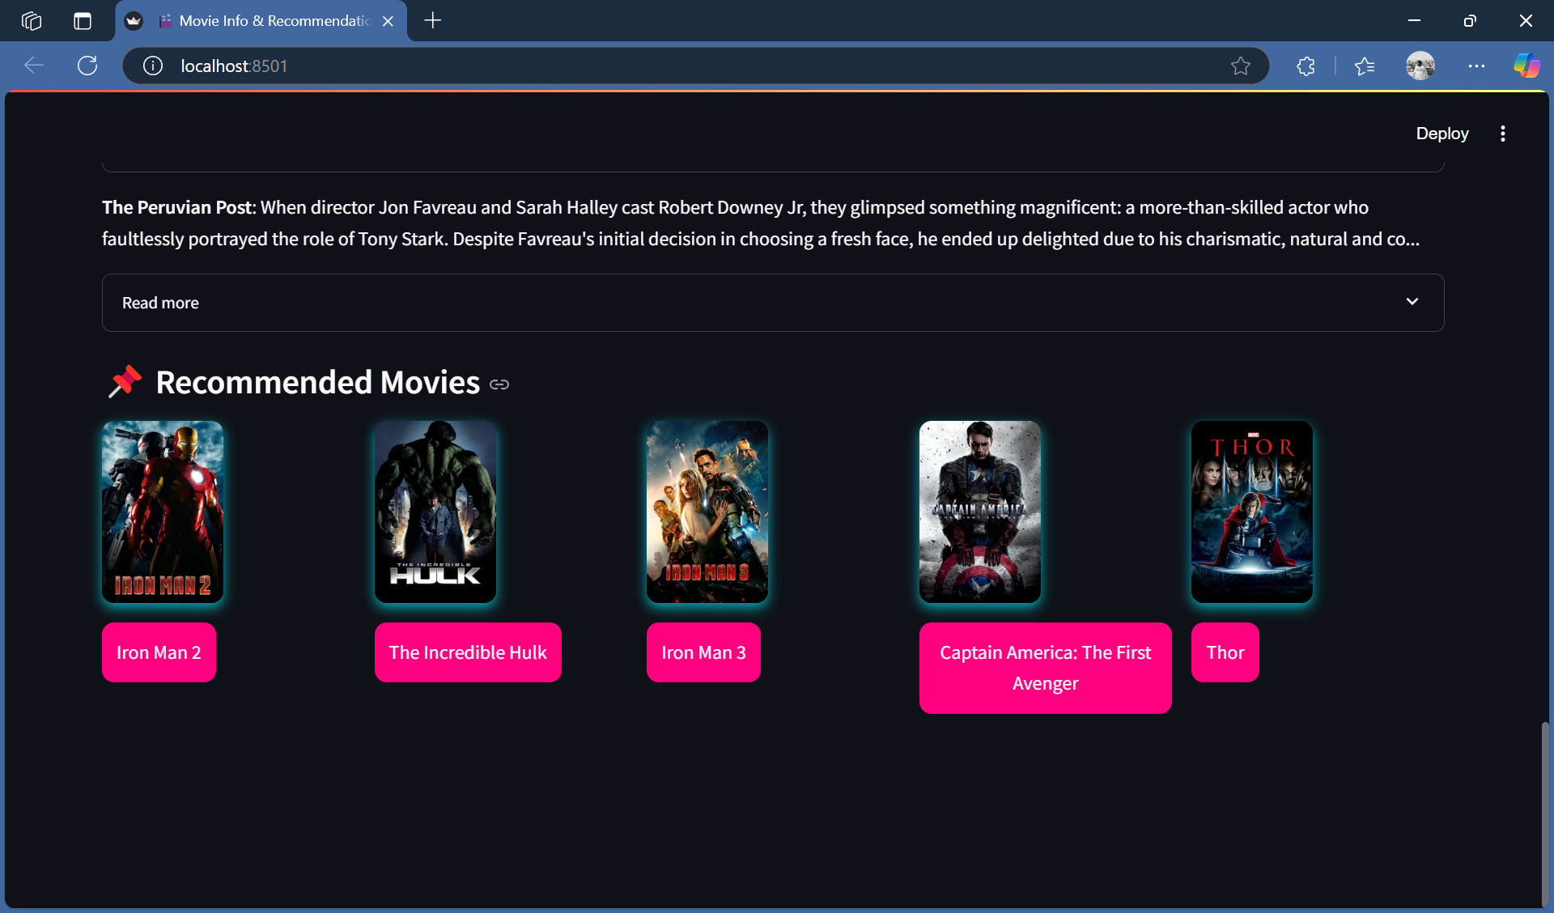
Outcomes of project:

Slide 13
Conclusion
The system successfully improves movie discovery by harnessing real-time data integration and personalized recommendation algorithms.
Instead of overwhelming users with a generic list of popular titles, it dynamically gathers up-to-date movie information—ranging from detailed overviews and cast profiles to user reviews—through continuous data calls to the TMDb API.
This real-time integration ensures that the recommendations are both current and reflective of recent trends or releases.

Slide 14
Future Perspective
Add user authentication and history-based recommendations:
User Authentication
History-Based Recommendations
Integrate ratings and user feedback:
User Ratings
User Feedback
Expand to include TV shows and multi-language support:
TV Shows Integration
Multi-Language Support
Mobile-friendly version:
Responsive Design
Enhanced User Experience

Slide 15
Demo Video Link:
https://drive.google.com/file/d/1dV2McPDr2jvgchYQs6lMnx21YwFSJ1cT/view?usp=drive_link

Slide 16



Thank you ☺ (But Remember….)
"Lights on—your moment begins.
Camera rolling—your potential is real.
Action—because dreams don't wait."

